Slide 1
Team – Earth Name – Triksha Hulagabali Head of Human Resource
Assignment Taken :
HR Recruitment and Training Plan
Title :
AIRWAY Delivery : A new business opportunity
HR Recruitment and Training Plan
This Photo by Unknown Author is licensed under CC BY-SA

Slide 11
de

Slide 13
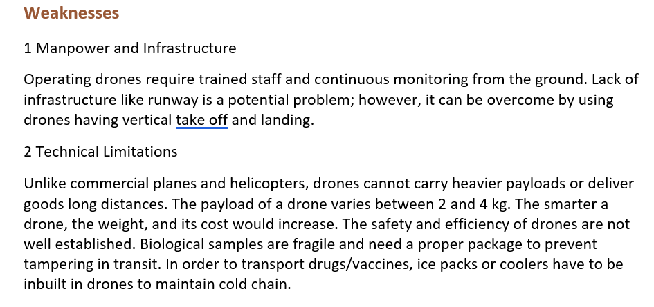
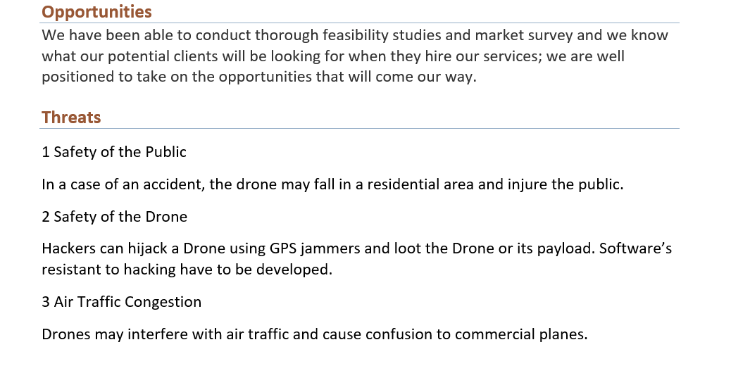
SWOT Analysis
d

Slide 14
Target Market & Advertising Strategy

Slide 16
Advertising strategy
.
Determine the purpose of advertising
Determine your target audience
Decide your advertising budget size
Measure the effectiveness of advertising
Implementation of the advertising program
Selecting media for advertising and deciding the schedule

Slide 19
Thankyou

